Slide 1
printer
Made by: tamás németh

Slide 2
WHAT IS PRINTER?
A printer is an output device that produces text and graphics on paper.
Many printers are primarily used as local peripherals, and are attached by a printer cable or, in most newer printer, a USB cable to a computer which serves as a document source.

Slide 3
PRINTER EVOLUTION
Dot Matrix Era (1970s-1980s):
Noisy, low resolution, and primarily used for basic text.
Inkjet Revolution (1980s-1990s):
Improved print quality, versatility, and affordability. Became popular for both home and office use.
Laser Precision (1980s-Present):
Faster printing, higher quality, and cost-effective for text-heavy documents. Commonly used in offices.
All-in-One Solutions (2000s-Present):
Increased functionality, space-saving, and improved connectivity. Ideal for multifunctional needs.
3D Printing Revolution (2010s-Present):
Transformational for prototyping, manufacturing, and customization. Extended beyond traditional document printing.

Slide 4
TYPE OF PRINTER
Impact- and non-Impact printer.
Impact printer produces text and images when tiny wire pins on print head strike the ink ribbon by physically contacting the paper.
Non-impact printer -> Doesn’t strike the paper.
Print method, Print technology
Popular: inkjet printer, laser printer, dot-matrix printer and thermal printer.

Slide 5
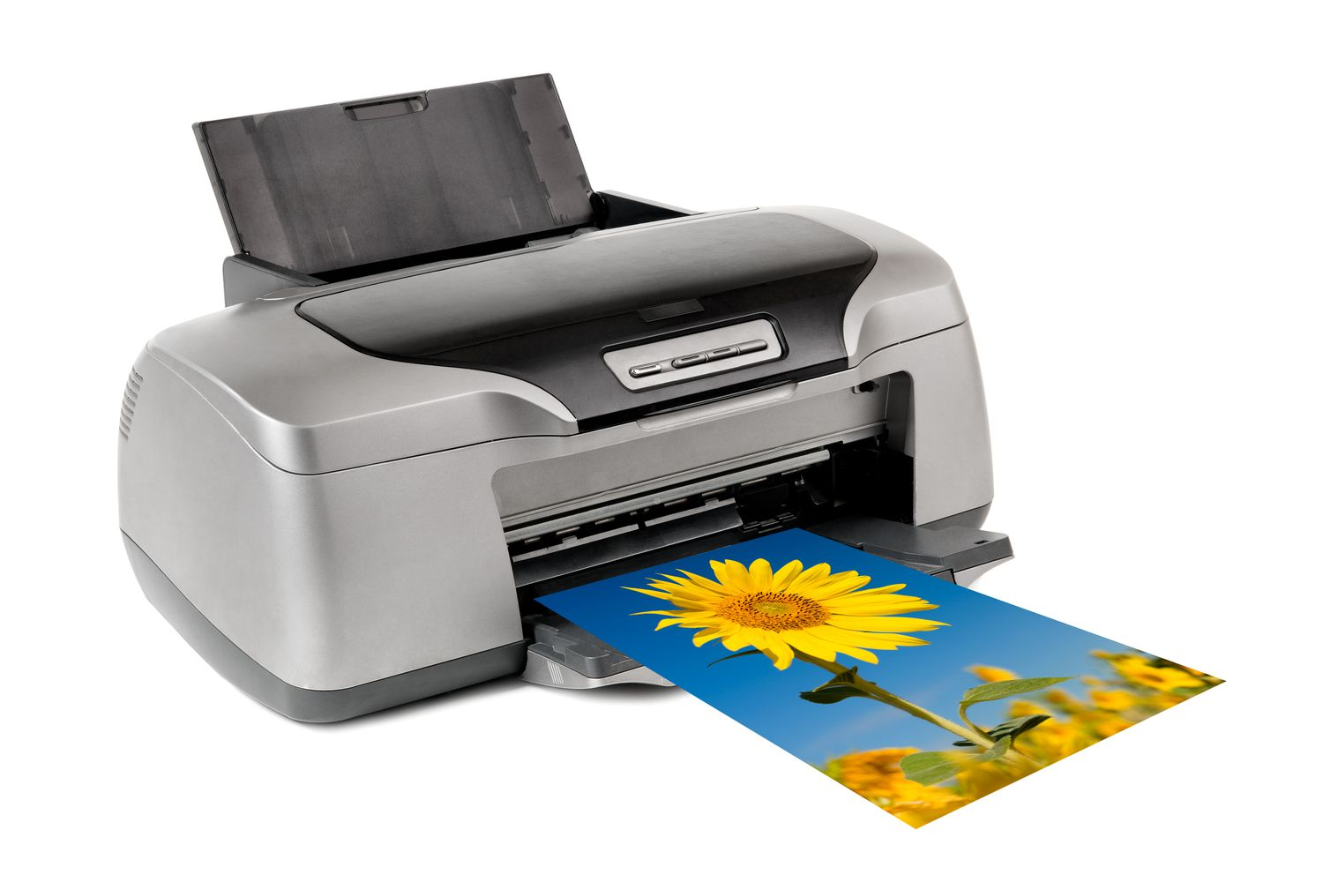
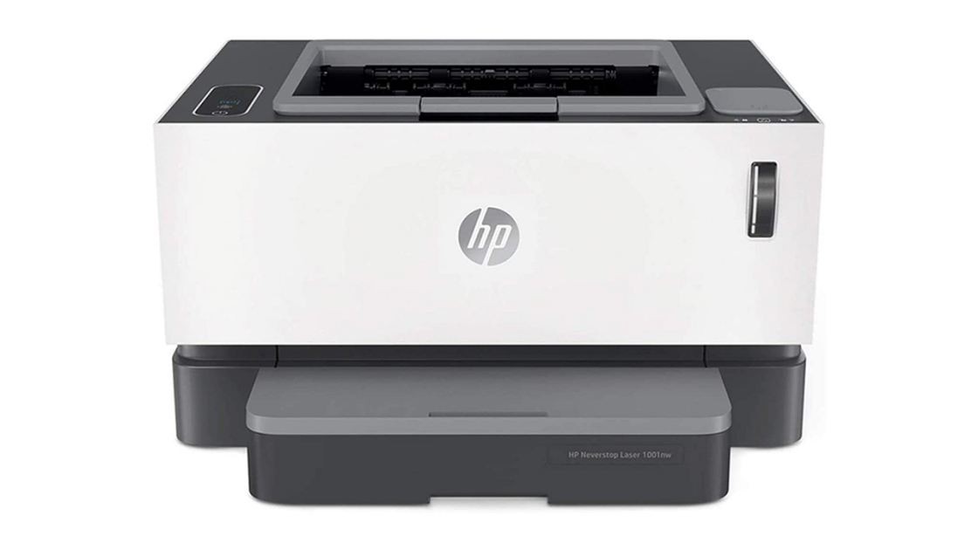
TWO POPULAR PRINTER TYPES
INKJET PRINTER
LASER PRINTER
An inkjet printer is a type of computer printer that reproduces a digital image by propelling variably-sized droplets of liquid material(ink) onto a page.
Laser printers are non-impact printers which can print text and images in high speed and high quality resolution.

Slide 6
FUTURE TRENDS IN PRINTING
Nanotechnology Integration:
Atomic level details
Improved print quality, and the ability to work with novel materials.
Bioprinting:
Bioprinting involves the use of 3D printing technology to create living tissues and organs by layering biological materials.
Can be used for personalized medicine, organ transplantation, and drug testing.
3D Metal Printing:
3D printing is a process of creating three-dimensional objects by layering materials based on a digital model. 3D printing adds material layer by layer.

